Slide 1
Car key detector
SAI VARUN T(202AD130)

Slide 2
ABSTRACT
Keys are usually easily misplaced, be it car keys, apartment keys, or any other key in your possession we almost always find ourselves misplacing our keys.
To address the issue with car keys where there is a wild card where one might find themselves being locked out of their own vehicle. The motive is to place sensors all over the car so that we can help make sure that we don’t lock ourselves out with the keys inside of the car.
We can place a sensor inside the key which acts like a repellent that repels the car doors from locking automatically when the key is inside of the car and when the engine is off.

Slide 3
PROBLEM ADDRESSED
Nowadays we often tend to be forgetful about things, as it turns out most people forget that they’ve put their keys inside the car and lock themselves out.
This happens to be a really concerning issue since a vehicle has inevitably become a big part of our life like it or not. We misplace our keys way to often and it does not serve well all the time. Losing your keys elsewhere is one but being locked out of your own car is another.
In most cases as with cars being locked out of your apartments and houses is also a big issue these days. We almost always do not have a spare key to the place which makes it even harder and you’d have to go through so much more in order to set things right.

Slide 4
EXISTING SOLUTION TO THE PROBLEM
The existing solutions for this problem is to seek the assistance of a locksmith or to break down the window of the car which makes for a dramatic display so as to say.
Or you could seek assistance from a car workshop nearby or the assistance of an official to ensure security.

Slide 5
PROPOSED SOLUTION TO THE PROBLEM ADDRESSED
We can place sensors all over the car and also place another sensor inside of the key which acts as a repellent to the sensors which auto lock the car. The sensors inside the car would help you get a sense of whether or not the keys are inside of the car.
The repellents inside the key would only act about when the engine is off.
The technical aspects and sensor preference is left up to the developer to decide.

Slide 6
PROJECT WORK PLAN
Start off by designing the model and decide where to place the sensors.
Choose the appropriate sensor.
Make a on paper design.
Try it out by constructing a prototype.

Slide 7
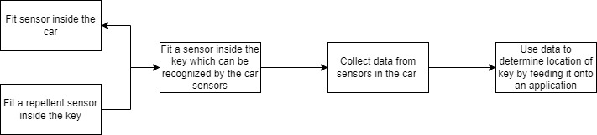
BLOCK DIAGRAM

Slide 8
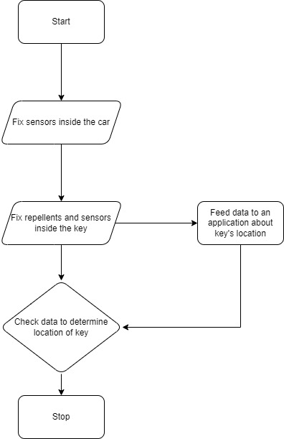
FLOW CHART

Slide 9
TECHNOLOGY STACK AND USE CASE
This is a pure out hardware project where we will be working with sensors and hardware components by testing scalability and miniaturizing the sensors based on the corresponding throughput.
The use case of this product would be subjective to the domain. It is a generic proposal, where in a single objective is taken in hand to achieve the objective at hand.

Slide 10
ANALYSIS OF RESULT AND DISCUSSION
We can conclude by stating that the product at hand is only scalable based on the domain at hand. Given the current choice at hand i.e., car keys, we can also use the same ideology proposed for any type of key and make it a generic key detector.
It all depends on what the user expects the product to be and how scalable the chosen sensors are to make it as generically useful as possible.

Slide 11
REFERENCE
https://brightside.me/inspiration-tips-and-tricks/these-10-ways-may-help-you-to-open-the-car-if-you-locked-the-keys-inside-402710/

